Slide 1



Futurion
Data Analysis
UPSKILLING INDIA
Portfoliio Project Challenge
LUNG CANCER ANALSYIS
01

Slide 2

Futurion
UPSKILLING INDIA
PROJECT NAME:
LUNG CANCER ANALSYIS
Name: Shivangi Singh
Date of submission: 21/02/2025
Tools Used: SQL,POWER BI
02

Slide 3

Futurion
Home
About us
Instructions
Tasks
Contact
UPSKILLING INDIA
PROBLEM STATEMENT:
Lung cancer remains one of the leading causes of death worldwide. Early detection, understanding risk factors, and analyzing treatment effectiveness are crucial for reducing mortality rates. With growing concerns about smoking habits, air pollution, and lifestyle choices contributing to lung cancer prevalence, there is a pressing need for comprehensive data analysis. This project focuses on analyzing the Lung Cancer Prediction Dataset, which contains patient records, demographic details, medical histories, and lifestyle factors to identify key risk factors, improve early detection strategies, and evaluate treatment outcomes.
OBJECTIVE:
1. Identify High-Risk Factors: Analyze the impact of smoking habits, passive smoking, air pollution exposure, and genetic predispositions on lung cancer diagnosis.
2. Evaluate Demographics: Examine lung cancer prevalence across different age groups, genders, and countries.
3. Assess Early Detection & Treatment: Determine how early detection and various treatment types influence survival rates and patient outcomes.
4. Analyze Mortality & Prevalence Trends: Identify countries with the highest lung cancer deaths and study the mortality rate vs. treatment type and air pollution exposure.
5. Develop Predictive Insights: Build data-driven strategies to predict lung cancer risks and recommend preventive measures.
6. Visualize Key Metrics: Create an interactive 3-page dashboard highlighting KPIs, risk factors, treatment analysis, and survival insights for stakeholders.
03

Slide 4
Futurion
UPSKILLING INDIA
The Lung Cancer Prediction Dataset comprises patient-level records with detailed information on demographics, lifestyle factors, medical history, and lung cancer diagnosis outcomes. The dataset includes the following 25 columns**:- ID: Unique patient identifier
Country: Patient's country of residence
Population _Size: Country's population size
Age: Age of the patient
Gender: Gender (Male/Female)
Smoker: Smoking status (Yes/No)
Years_of_Smoking: Duration of smoking in years
Cigarettes_per_Day: Average number of cigarettes smoked daily
Passive_Smoker: Exposure to secondhand smoke (Yes/No)
Family_History: Family history of lung cancer (Yes/No)
Lung_Cancer_Diagnosis: Diagnosis result (Positive/Negative)
Cancer_Stage: Stage of lung cancer (I, II, III, IV)
Survival_Years: Years of survival post-diagnosis
Adenocarcinoma_Type: Type classification (if applicable)
Air_Pollution_Exposure: Level of exposure to air pollution
Occupational_Exposure: Exposure to hazardous work environments (Yes/No)
Indoor_Pollution: Exposure to indoor pollutants (Yes/No)
Healthcare_Access: Access to medical care (Good/Average/Poor)
Early_Detection: Whether lung cancer was detected early (Yes/No)
Treatment_Type: Type of treatment received (Chemotherapy, Surgery, Radiation, etc.)
Developed_or_Developing: Country classification
Annual_Lung_Cancer_Deaths: Annual reported deaths due to lung cancer
Lung_Cancer_Prevalence_Rate: Prevalence rate per population
Mortality_Rate: Mortality percentage
Risk_Score: Calculated score indicating lung cancer risk
DATASET OVERVIEW
Task 02
Normalize or standardize relevant fields (e.g., age, blood counts).
04

Slide 5
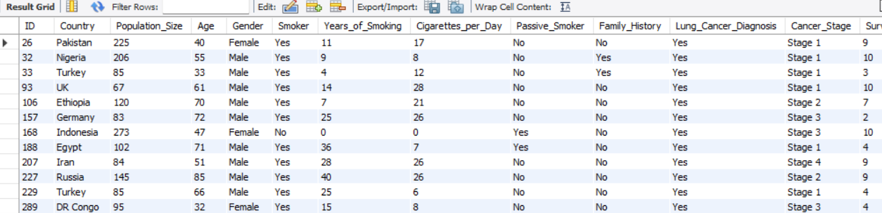
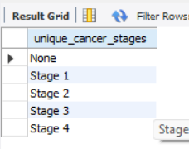



Futurion
SQL QUERIES AND SOLUTION
UPSKILLING INDIA
Basic Level—
1. Retrieve all records for individuals diagnosed with lung cancer.
QUERY: select * from lung_cancer_data
where Lung_Cancer_Diagnosis='Yes’;
2. Count the number of smokers and non-smokers.
QUERY: select count(Smoker) AS Count_of_smokers
from lung_cancer_datawhere Smoker='Yes’;
select count(Smoker) AS Count_of_nonsmokers
from lung_cancer_data where Smoker='No’;
3. List all unique cancer stages present in the dataset.
QUERY: select distinct(Cancer_Stage) AS unique_cancer_stages
from lung_cancer_data;
4. Retrieve the average number of cigarettes smoked per day by smokers.
QUERY: select avg(Cigarettes_per_Day) AS Average_of_Cigarettes_per_Day
from lung_cancer_data where Smoker='Yes’;
05

Slide 6

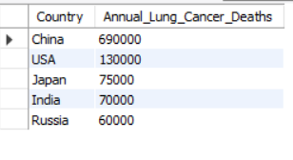
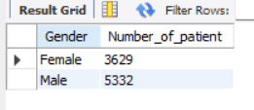
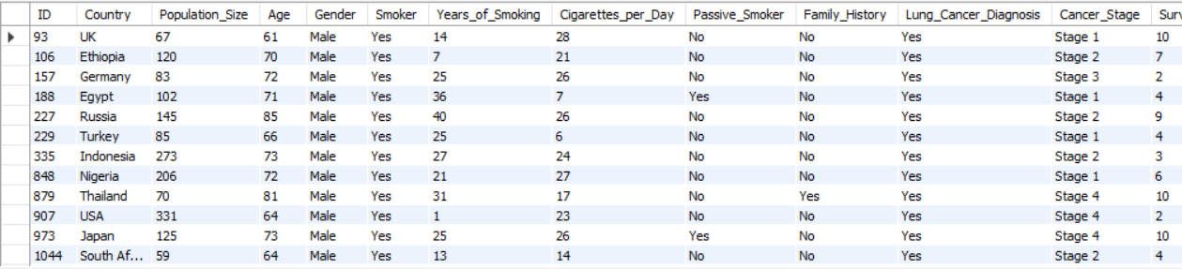
Futurion
SQL QUERIES AND SOLUTION
UPSKILLING INDIA
5. Count the number of people exposed to high air pollution.
QUERY: select count(Population_Size) AS No_of_people_exposed_to_high_pollution from lung_cancer_datawhere Air_Pollution_Exposure='High’;
6. Find the top 5 countries with the highest lung cancer deaths.
QUERY: select distinct(Country), Annual_Lung_Cancer_Deaths from lung_cancer_dataorder by Annual_Lung_Cancer_Deaths Desclimit 5;
7. Count the number of people diagnosed with lung cancer by gender.
QUERY: select Gender, count(*) AS Number_of_patient from lung_cancer_datawhere Lung_Cancer_Diagnosis='Yes'GROUP BY Gender;
8. Retrieve records of individuals older than 60 who are diagnosed with lung cancer.
QUERY: select * from lung_cancer_datawhere age>60 AND Lung_Cancer_Diagnosis='Yes';
06

Slide 7

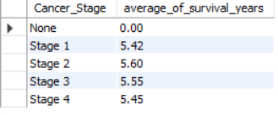


Futurion
SQL QUERIES AND SOLUTION
UPSKILLING INDIA
-- Intermediate Level
1. Find the percentage of smokers who developed lung cancer.
QUERY: select round((count(*)*100)/(select count(*) from lung_cancer_data where Smoker='Yes'),2)
AS percentage_of_smokerfrom lung_cancer_data
where Smoker='Yes' and Lung_Cancer_Diagnosis= ' Yes ‘;
2. Calculate the average survival years based on cancer stages.
QUERY: select Cancer_Stage,round(avg(Survival_Years),2) AS average_of_survival_years
from lung_cancer_data group by Cancer_Stage order by Cancer_Stage;
3. Count the number of lung cancer patients based on passive smoking.
QERY: select Passive_Smoker ,count(*) AS Lung_Cancer_Patientfrom lung_cancer_data
where Lung_Cancer_Diagnosis='Yes’ group by Passive_Smoker;
4. Find the country with the highest lung cancer prevalence rate.
QUERY:select country,Lung_Cancer_Prevalence_Rate from lung_cancer_data
order by Lung_Cancer_Prevalence_Rate desc limit 1;
07

Slide 8
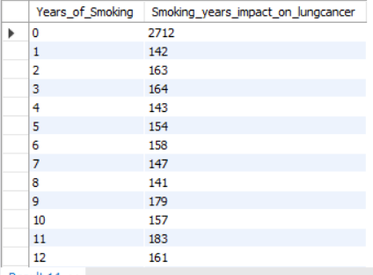


Futurion
SQL QUERIES AND SOLUTION
UPSKILLING INDIA
5. Identify the smoking years' impact on lung cancer.
QUERY: select Years_of_Smoking,count(*) AS Smoking_years_impact_on_lungcancer
from lung_cancer_data where Lung_Cancer_Diagnosis='Yes’
group by Years_of_Smoking order by Years_of_Smoking;
6. Determine the mortality rate for patients with and without early detection.
QUERY: select Early_Detection,round(avg(Mortality_Rate),2) AS Mortality_rate
from lung_cancer_data group by Early_Detection order by Early_Detection;
7. Group the lung cancer prevalence rate by developed vs. developing countries.
QUERY: select Developed_or_Developing,round(avg(Lung_Cancer_Prevalence_Rate),2)
AS lung_cancer_prevelence_rate from lung_cancer_data
group by Developed_or_Developing order by Developed_or_Developing;
08

Slide 9
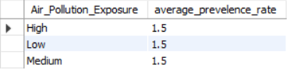
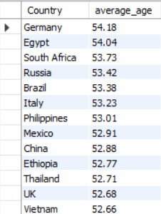
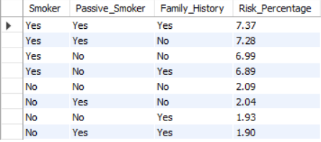
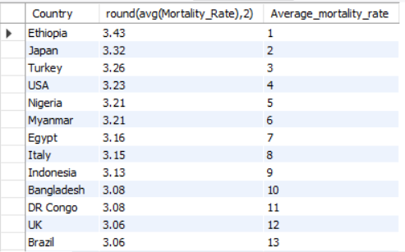
Futurion
SQL QUERIES AND SOLUTION
UPSKILLING INDIA
-- Advanced Level
Identify the correlation between lung cancer prevalence and air pollution levels.
QUERY: select Air_Pollution_Exposure,round(avg(Lung_Cancer_Prevalence_Rate),2) AS average_prevelence_rate from lung_cancer_data group by Air_Pollution_Exposure
order by Air_Pollution_Exposure;
2. Find the average age of lung cancer patients for each country.
QUERY: select Country,round(avg(Age),2) AS average_agefrom lung_cancer_data where Lung_Cancer_Diagnosis='Yes’ group by Country order by average_age desc;
3. Calculate the risk factor of lung cancer by smoker status, passive smoking,
and family history.
QUERY: SELECT Smoker,Passive_Smoker, Family_History,
ROUND((COUNT(CASE WHEN Lung_Cancer_Diagnosis = 'Yes' THEN 1 END) * 100.0) /
COUNT(*), 2) AS Risk_Percentage FROM lung_cancer_data GROUP BY Smoker,
Passive_Smoker, Family_History ORDER BY Risk_Percentage DESC;
4. Rank countries based on their mortality rate.
QUERY: select Country,round(avg(Mortality_Rate),2) ,rank()
over(order by avg(Mortality_Rate) desc) AS Average_mortality_rate
from lung_cancer_data group by Country;
09

Slide 10
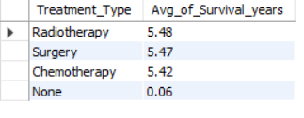
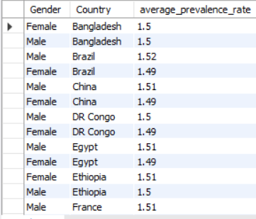
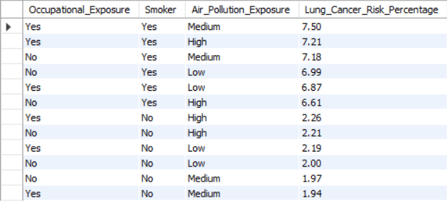

Futurion
SQL QUERIES AND SOLUTION
UPSKILLING INDIA
5. Determine if treatment type has a significant impact on survival years.
QUERY: select Treatment_Type ,round(avg(Survival_years),2) AS Avg_of_Survival_years from lung_cancer_data group by Treatment_Type
order by Avg_of_Survival_years desc;
6. Compare lung cancer prevalence in men vs. women across countries.
QUERY: select Gender,Country,round(avg(Lung_Cancer_Prevalence_Rate),2) AS average_prevalence_rate from lung_cancer_data group by Country,Gender
order by Country,average_prevalence_rate desc;
7. Find how occupational exposure, smoking, and air pollution collectively impact lung cancer rates.
QUERY: SELECT Occupational_Exposure,Smoker, Air_Pollution_Exposure, ROUND((COUNT(CASE WHEN Lung_Cancer_Diagnosis = 'Yes' THEN 1 END) * 100.0) / COUNT(*), 2) AS Lung_Cancer_Risk_PercentageFROM lung_cancer_data GROUP BY Occupational_Exposure,Smoker, Air_Pollution_Exposure
ORDER BY Lung_Cancer_Risk_Percentage DESC;
8. Analyze the impact of early detection on survival years.
QUERY: select Early_Detection ,round(avg(Survival_years),2) AS Avg_of_Survival_years from lung_cancer_data group by Early_Detection
order by Avg_of_Survival_years desc;
10

Slide 11
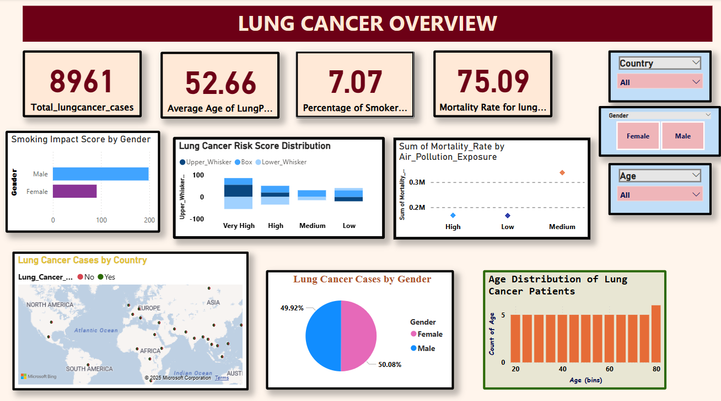
DASHBOARD 1
11

Slide 12
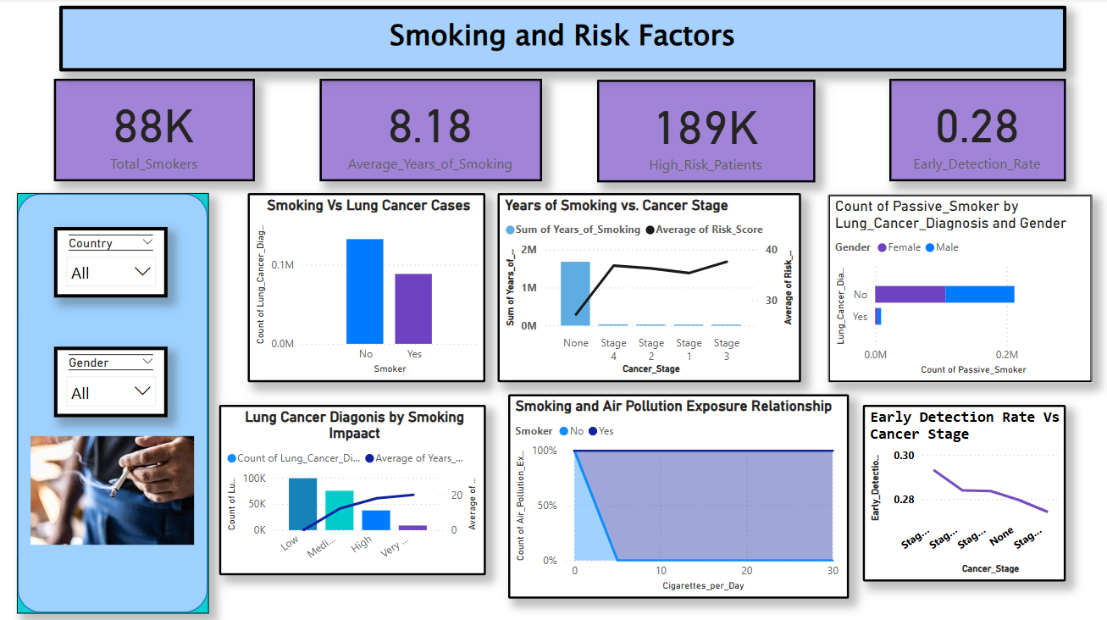
DASHBOARD 2
12

Slide 13
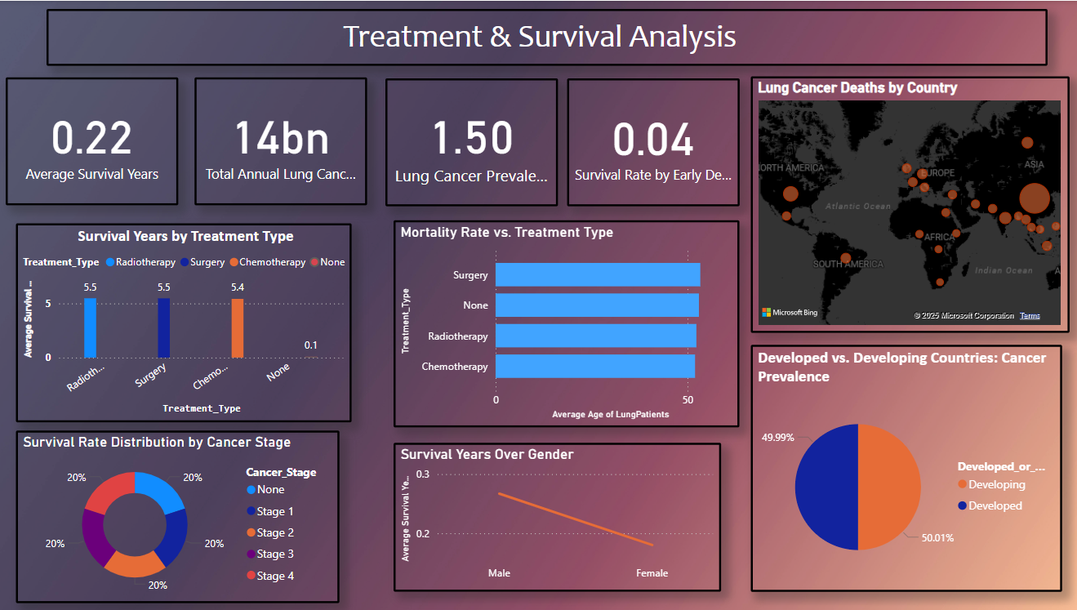
DASHBOARD 3

Slide 14
Futurion
CONCLUSION & BUSSINESS RECOMMENDATIONS
UPSKILLING INDIA
Summarize Findings & Insights: The lung cancer prediction dataset reveals significant risk factors, including smoking habits, passive smoking, air pollution exposure, and family history. Countries with higher smoking rates and pollution levels show increased lung cancer prevalence and mortality rates. Early detection significantly improves survival rates, while certain treatment types lead to better patient outcomes.
Actionable Business Recommendations:
Promote anti-smoking campaigns and stricter air quality regulations in high-risk countries.
Invest in early detection programs to enhance survival rates.
Develop targeted healthcare strategies for high-risk populations based on demographic and lifestyle factors.
Encourage research on treatment types that maximize survival years.
Focus on preventive care in developing countries to reduce lung cancer cases.
14

Slide 15
Futurion
UPSKILLING INDIA
REFERENCES & ACKNOWLEDGMENTS
Data Sources & Tools:
Dataset: Lung Cancer Prediction Dataset containing demographic, medical, and lifestyle factors.
Tools Used: SQL for data extraction, Power BI for dashboard creation.
Acknowledgments:
Thanks to mentors, team members, and healthcare data contributors.
Inspired by global efforts to improve lung cancer detection, prevention, and treatment.
15

